Slide 1
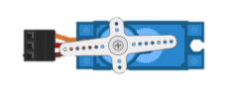
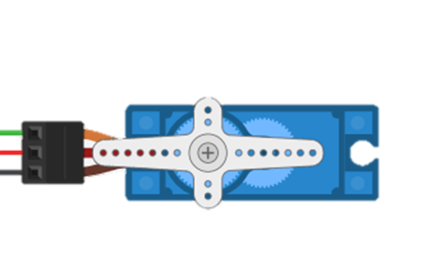



Steering

Slide 2
/*
Steer and POT
Modified using Sweep
*/
#include <Servo.h>
int pos = 90;
int oldpos = 90;
int leftpin = 13;
int rightpin = 11;
int centpin = 12;
int potpin = 0;
int leftbuttonstate = 0;
int rightbuttonstate = 0;
int centbuttonstate = 0;
int val;
int j = 1;
int i;
Servo servo_9;
void setup()
{
servo_9.attach(9);
pinMode(leftpin, INPUT);
pinMode(rightpin, INPUT);
pinMode(centpin, INPUT);
}
void loop()
{
val = analogRead(potpin);
val = map(val, 0, 1023, 0, 180);
pos = val;
leftbuttonstate = digitalRead(leftpin);
rightbuttonstate = digitalRead(rightpin);
centbuttonstate = digitalRead(centpin);
if (leftbuttonstate == HIGH ) {
pos = 180;
j=1;
}
if (rightbuttonstate == HIGH ) {
pos = 0;
j=-1;
}
if (centbuttonstate == HIGH ) {
if (pos > 90) { j = -1;} else {j = 1;}
pos = 90;
}
if (j=1) {
for (i = oldpos; i <= pos; i += 1) {
servo_9.write(pos);
delay(1);
}}
else {
for (i = oldpos; i >= pos; i += -1) {
servo_9.write(pos);
delay(1);
}}
oldpos = pos;
}

Slide 3
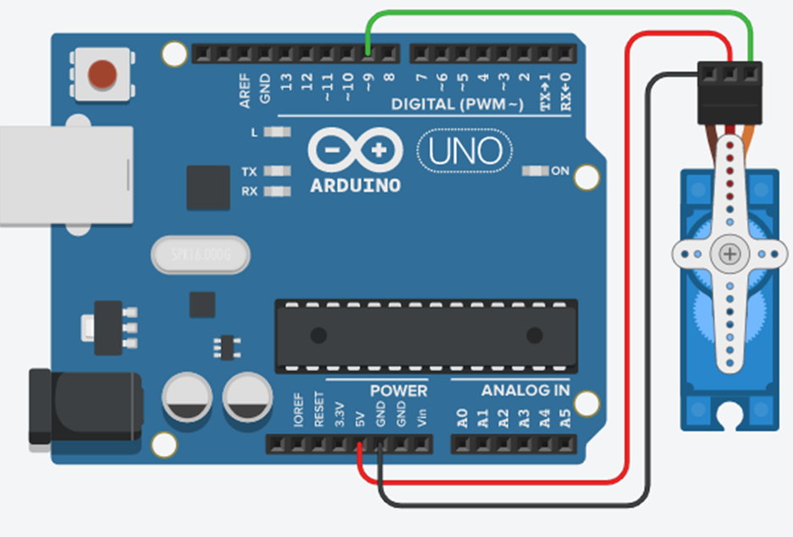
Start with the Servo Script
/* Sweep
by BARRAGAN <http://barraganstudio.com>
This example code is in the public domain.
modified 8 Nov 2013
by Scott Fitzgerald
http://www.arduino.cc/en/Tutorial/Sweep
*/
#include <Servo.h>
Servo myservo; // create servo object to control a servo
// twelve servo objects can be created on most boards
int pos = 0; // variable to store the servo position
void setup() {
myservo.attach(9); // attaches the servo on pin 9 to the servo object
}
void loop() {
for (pos = 0; pos <= 180; pos += 1) { // goes from 0 degrees to 180 degrees
// in steps of 1 degree
myservo.write(pos); // tell servo to go to position in variable 'pos'
delay(15); // waits 15ms for the servo to reach the position
}
for (pos = 180; pos >= 0; pos -= 1) { // goes from 180 degrees to 0 degrees
myservo.write(pos); // tell servo to go to position in variable 'pos'
delay(15); // waits 15ms for the servo to reach the position
}
}
Use the Servo connected to +ve 5v and –ve ground and also to Pin 9 which is a PWM connection which is used by the Servo software to drive the Servo to the required position from 0 to 180 degrees. Start the code on your Arduino UNO and observe the motion of the Servo and the code printed here.

Slide 4
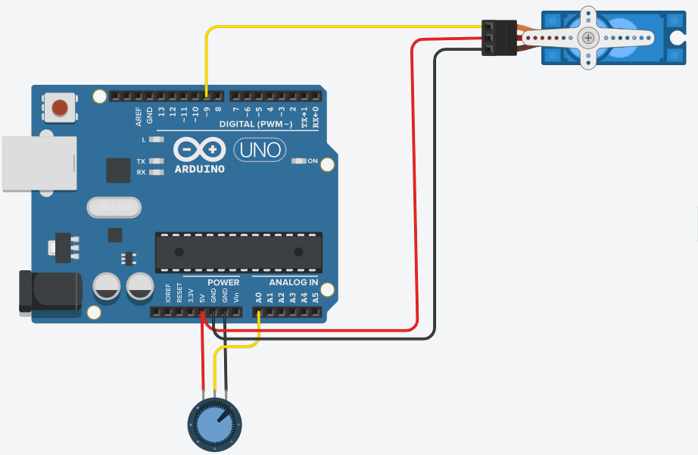
Add a potentiometer (the knob), the pot is connected to both the +ve 5v and the –ve Ground. The 3rd pin is the wiper of the pot and needs to be connected to an analogue port, port A0 in this case. Use the Knob example and load the code onto the Arduino. Use the knob to rotate the Servo Arm.

Slide 5
/*
Controlling a servo position using a potentiometer (variable resistor)
by Michal Rinott <http://people.interaction-ivrea.it/m.rinott>
modified on 8 Nov 2013
by Scott Fitzgerald
http://www.arduino.cc/en/Tutorial/Knob
*/
#include <Servo.h>
Servo myservo; // create servo object to control a servo
int potpin = 0; // analog pin used to connect the potentiometer
int val; // variable to read the value from the analog pin
void setup() {
myservo.attach(9); // attaches the servo on pin 9 to the servo object
}
void loop() {
val = analogRead(potpin); // reads the value of the potentiometer (value between 0 and 1023)
val = map(val, 0, 1023, 0, 180); // scale it to use it with the servo (value between 0 and 180)
myservo.write(val); // sets the servo position according to the scaled value
delay(15); // waits for the servo to get there
This code is taken from the Knob example,
Locate the code which monitors the analogue port 0 we connected to earlier.
See how it is mapped to a range between 0 and 1023.
Take this code and copy it into your code and add it to your existing Steer Servo code.
You will need to take information from the library section as well as the setup and void sections.
You should be able to turn the Servo Arm using the knob.
(You will need to remove the code in Servo which sweeps the arm.

Slide 6
Adding a POT

Slide 7
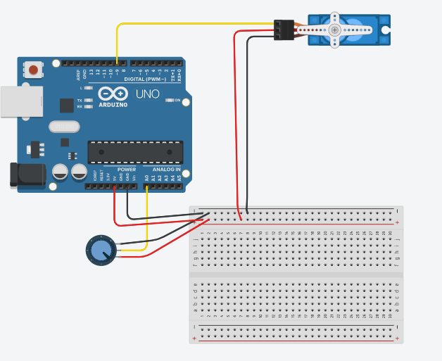
Use a breadboard and move the wiring for the Arduino, POT and the Servo onto the breadboard.
Make sure the code is still working.

Slide 8
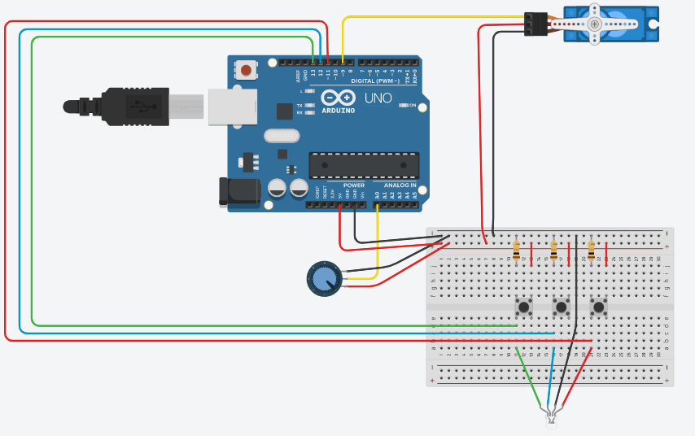
Add the 3 buttons and three 10K resistors to the breadboard and add the red wires to the breadboard and also the wires across to the Arduino on pins 11,12 and 13
Add the 3 colour LED and wire across to the button outputs and ground.

Slide 9
int leftpin = 13;
int leftbuttonstate = 0;
int pos = 90;
int oldpos = 90;
int j = 1;
int i;
void setup()
{
pinMode(leftpin, INPUT);
}
void loop()
{
pos = val;
leftbuttonstate = digitalRead(leftpin);
//if left button pressed desired position is left i.e. 180º
if (leftbuttonstate == HIGH ) {
pos = 180;
j=1;
}
//move rotor to new position (pos)
if (j=1) {
for (i = oldpos; i <= pos; i += 1) {
servo_9.write(pos);
delay(1);
}}
else {
for (i = oldpos; i >= pos; i += -1) {
servo_9.write(pos);
delay(1);
}}
oldpos = pos;
}
We need to update our code to make use of the buttons.
Here is the additional code for the left button. Enter this code and program the Arduino and then try it out. Does the arm move to the left.
The for loop moves it one degree at a time, the longer you press the more it turns left.
If you let go it should return to the position determined by the POT.

Slide 10
int rightpin = 11;
int centpin = 12;
int rightbuttonstate = 0;
int centbuttonstate = 0;
void setup()
{
pinMode(rightpin, INPUT);
pinMode(centpin, INPUT);
}
void loop()
{
rightbuttonstate = digitalRead(rightpin);
centbuttonstate = digitalRead(centpin);
if (rightbuttonstate == HIGH ) {
pos = 0;
j=-1;
}
if (centbuttonstate == HIGH ) {
if (pos > 90) { j = -1;} else {j = 1;}
pos = 90;
}
}
ow add the code for the centre and right buttons.
Load this onto the Arduino and test,
You now have the basics of a controller.
It would also be nice to add remote control so it becomes an RC model.

Slide 11
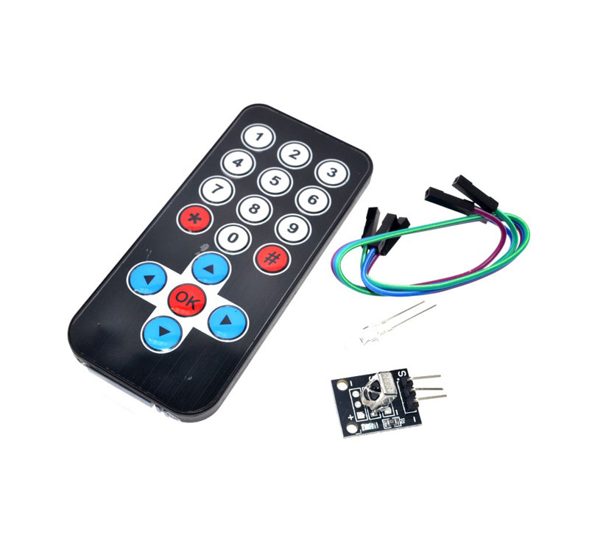
IR Remote Control

Slide 12
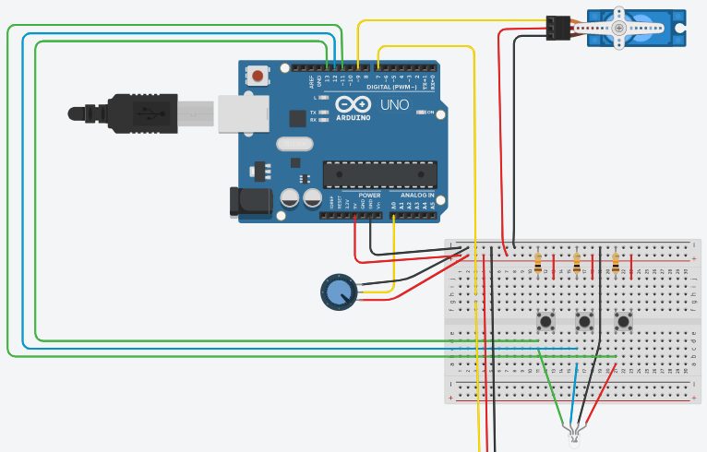
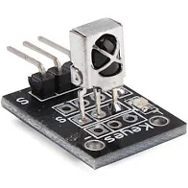
Now add the IR remote control module to the breadboard and connect the +ve and –ve and signal wires as shown.

Slide 13
#include <IRremote.h>
const int RECV_PIN = 7;
IRrecv irrecv(RECV_PIN);
decode_results results;
void setup() {
// use the serial monitor to see values associated with IR receiver
Serial.begin(9600);
irrecv.enableIRIn();
irrecv.blink13(true);
}
void loop() {
// monitor IR Receiver and print to serial monitor the value received
if (irrecv.decode(&results)){
Serial.println(results.value, HEX);
Serial.println(results.value);
irrecv.resume();
}
}
Use this code to test the IR receiver with the remote control. Try another remote control. See how the values change. Setup a serial monitor as shown in the next diagram.

Slide 14
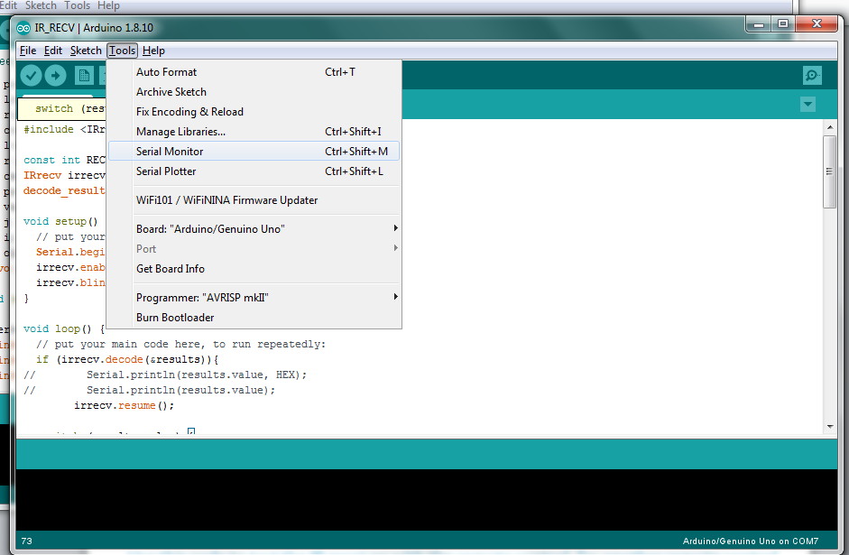
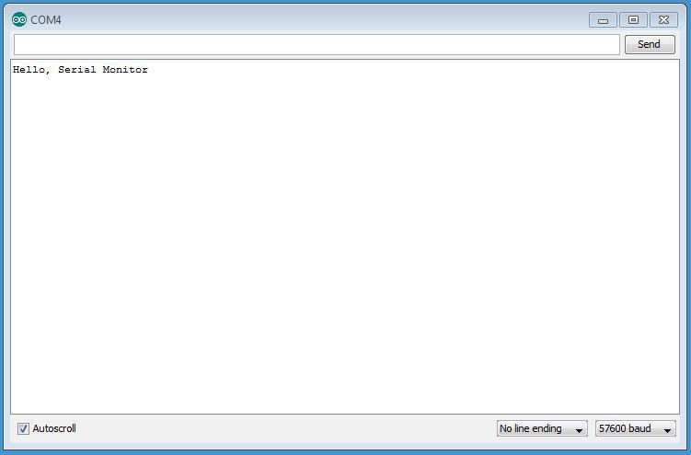
Serial Monitor
(USB needs to be attached to UNO

Slide 15

Record the values for each button pressed here:
IR Receive Codes
1 | 2 | 3
4 | 5 | 6
7 | 8 | 9
* | 0 | #
================ | ⬆ | ================
⬅ | OK | ➔
================ | ⬇ | ================

Slide 16
Add the following code to print to the serial monitor an arrow corresponding to the key pressed on the remote control.
switch (results.value) {
// remote control keys
case 16716015: //
Serial.println("<--");
break;
case 16734885: //
Serial.println("-->");
break;
case 16718055: //
Serial.println("/\\");
break;
case 16730805: //
Serial.println("\\/");
break;
}

Slide 17
The complete code for all keys:
#include <IRremote.h>
const int RECV_PIN = 7;
IRrecv irrecv(RECV_PIN);
decode_results results;
void setup() {
// put your setup code here, to run once:
Serial.begin(9600);
irrecv.enableIRIn();
irrecv.blink13(true);
}
void loop() {
// put your main code here, to run repeatedly:
if (irrecv.decode(&results)){
// Serial.println(results.value, HEX);
// Serial.println(results.value);
irrecv.resume();
switch (results.value) {
case 16753245: // remote control keys
Serial.println("1");
break;
case 16736925: //
Serial.println("2");
break;
case 16769565: //
Serial.println("3");
break;
case 16720605: //
Serial.println("4");
break;
case 16712445: //
Serial.println("5");
break;
case 16761405: //
Serial.println("6");
break;
case 16769055: //
Serial.println("7");
break;
case 16754775: //
Serial.println("8");
break;
case 16748655: //
Serial.println("9");
break;
case 16750695: //
Serial.println("0");
break;
case 16716015: //
Serial.println("<--");
break;
case 16734885: //
Serial.println("-->");
break;
case 16718055: //
Serial.println("/\\");
break;
case 16730805: //
Serial.println("\\/");
break;
case 16738455: //
Serial.println("*");
break;
case 16756815: //
Serial.println("#");
break;
case 16726215: //
Serial.println("OK");
break;
}
}
}

Slide 18
